Slide 1

Basics of Neural Network Programming
Vectorizing Logistic
Regression
deeplearning.ai
Notes:
<number>

Slide 2
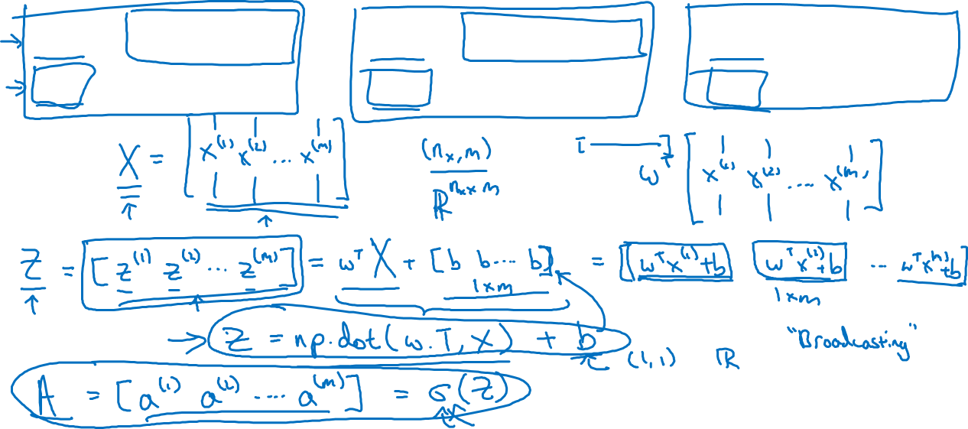
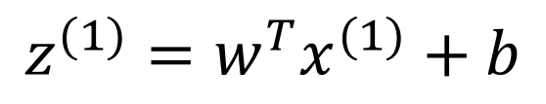
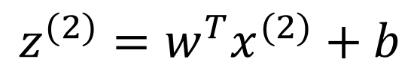
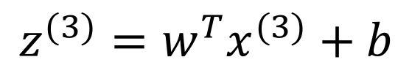

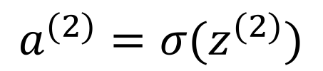

Vectorizing Logistic Regression
$z^{\left(1\right)}=w^{T}x^{\left(1\right)}+b$
$z^{\left(2\right)}=w^{T}x^{\left(2\right)}+b$
$z^{\left(3\right)}=w^{T}x^{\left(3\right)}+b$
$a^{\left(1\right)}=σ\left(z | | \left(1\right)\right)$
$a^{\left(2\right)}=σ\left(z | | \left(2\right)\right)$
$a^{\left(3\right)}=σ\left(z | | \left(3\right)\right)$

Slide 3
Basics of Neural Network Programming
Vectorizing Logistic
Regression’s Gradient
Computation
deeplearning.ai
Notes:
<number>

Slide 4
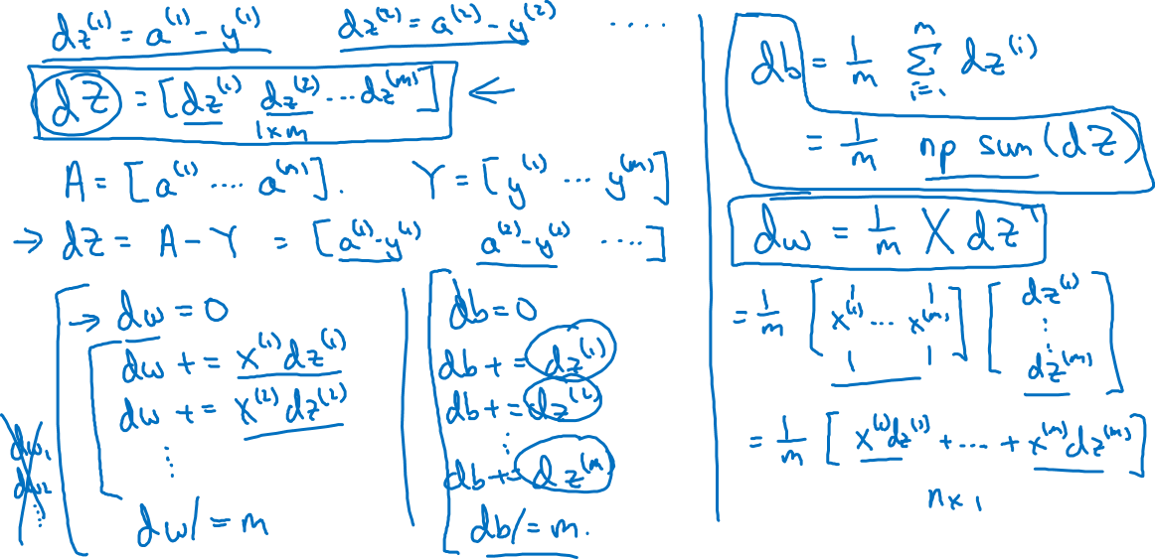
Vectorizing Logistic Regression

Slide 5
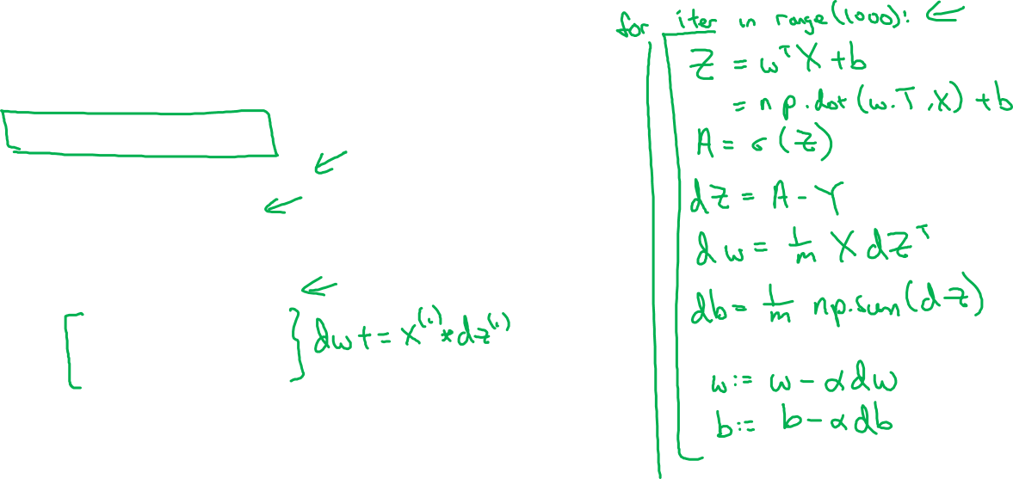
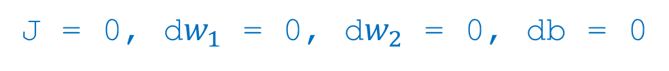
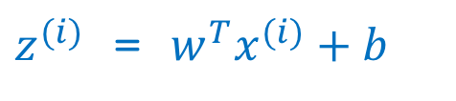
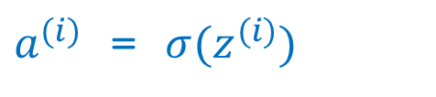
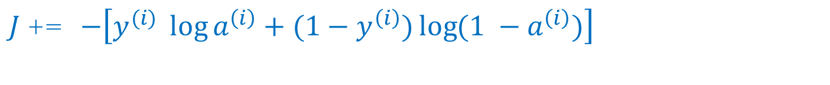
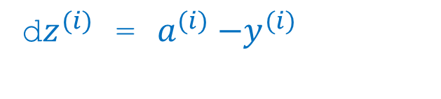
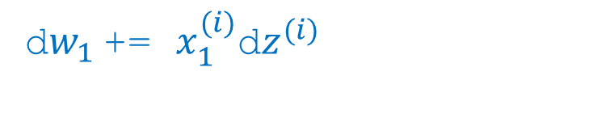
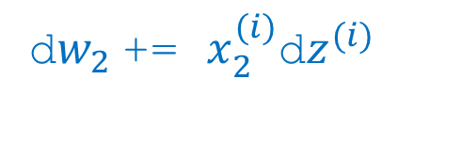

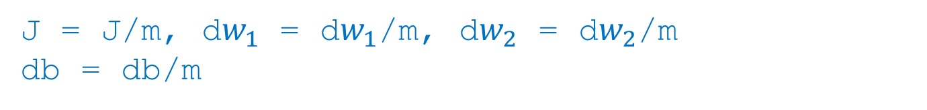
Implementing Logistic Regression
J = 0, d = 0, d = 0, db = 0
for i = 1 to m:
=
=
+=
d =
d+=
d+=
db += d
J = J/m, d = d/m, d = d/m
db = db/m

